Slide 1
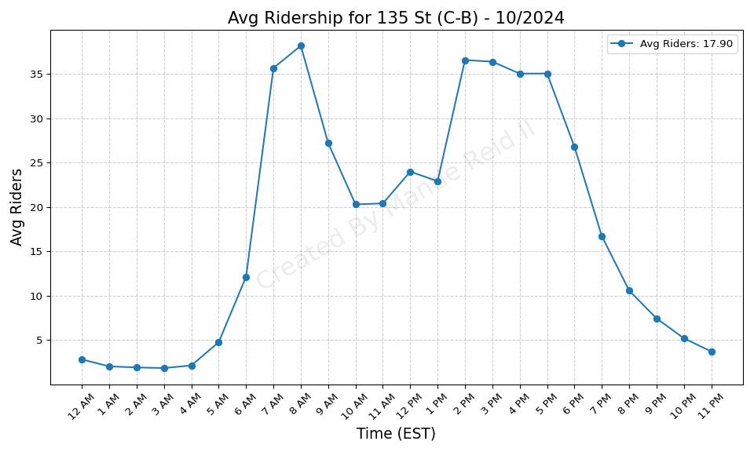
135 St (C-B) - 10/2024

Slide 2
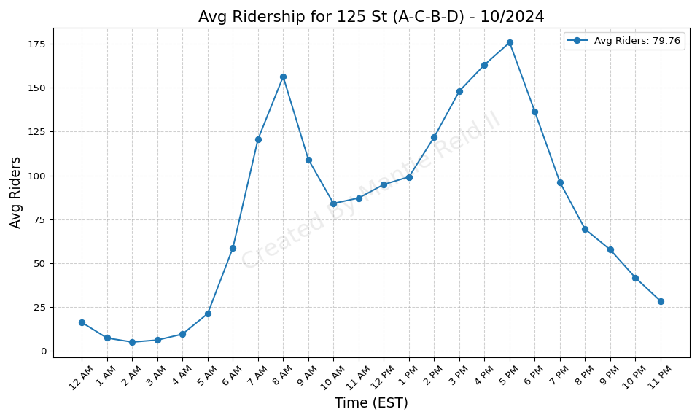
125 St (A-C-B-D) - 10/2024

Slide 3
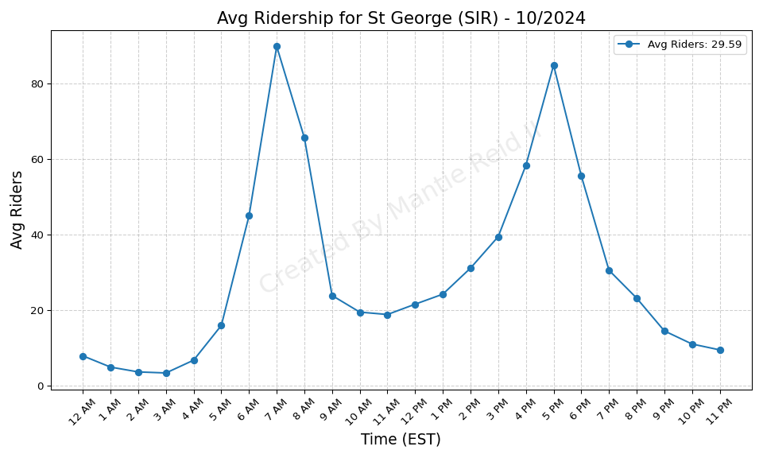
St George (SIR) - 10/2024

Slide 4
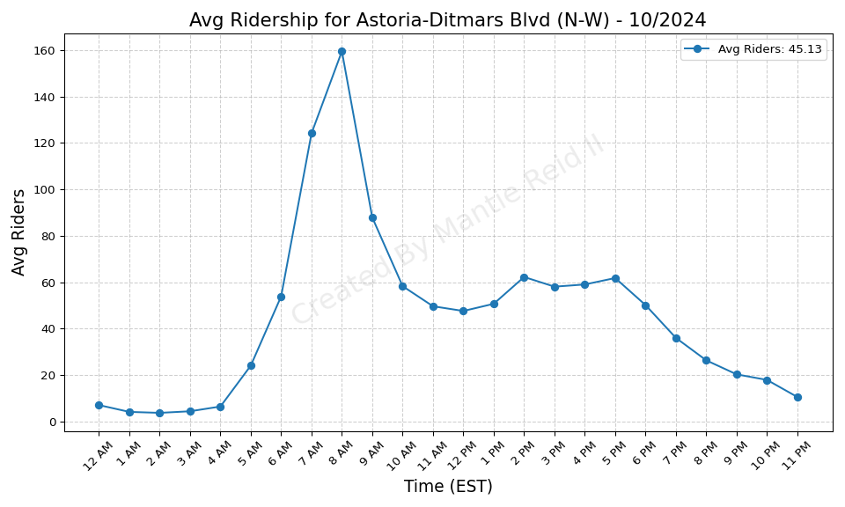
Astoria-Ditmars Blvd (N-W) - 10/2024

Slide 5
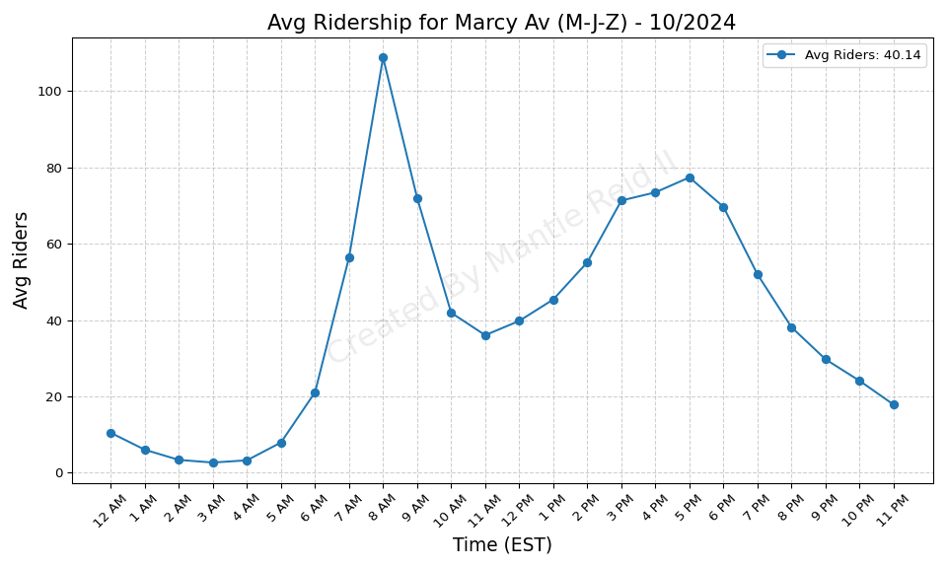
Marcy Av (M-J-Z) - 10/2024

Slide 6
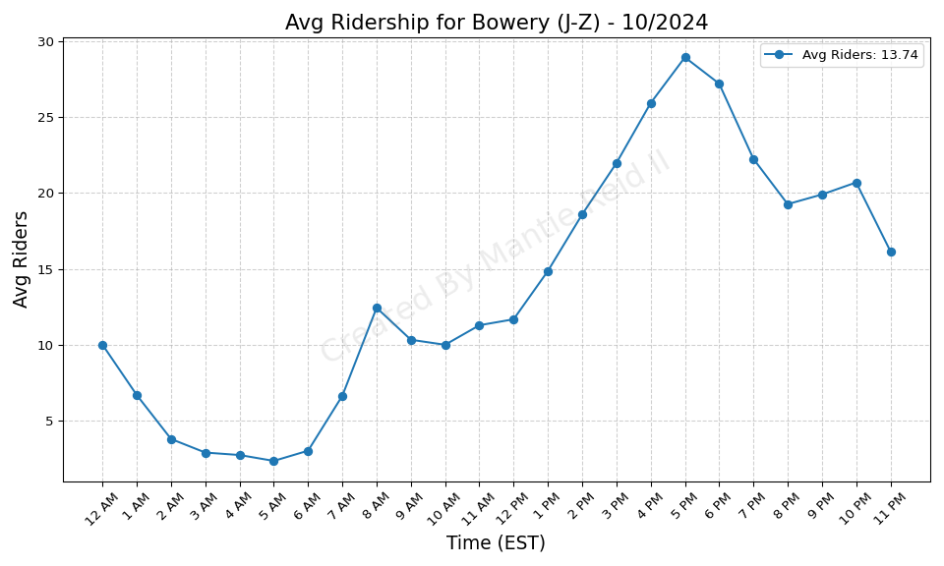
Bowery (J-Z) - 10/2024

Slide 7
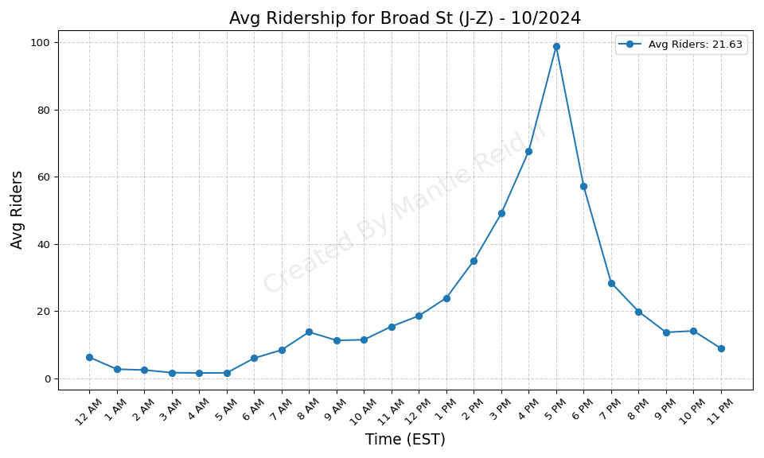
Broad St (J-Z) - 10/2024

Slide 8
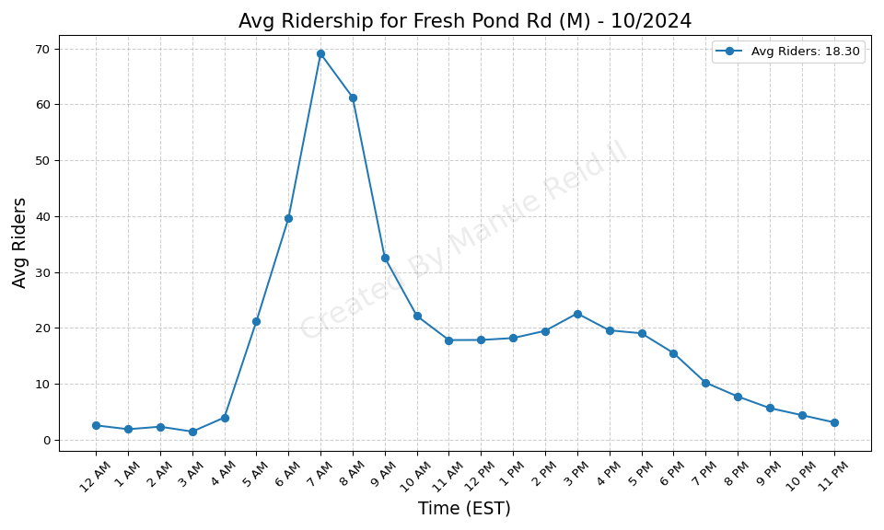
Fresh Pond Rd (M) - 10/2024

Slide 9
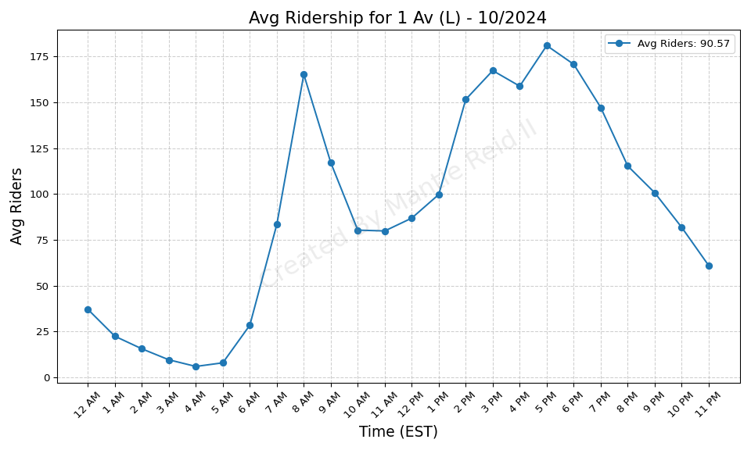
1 Av (L) - 10/2024

Slide 10
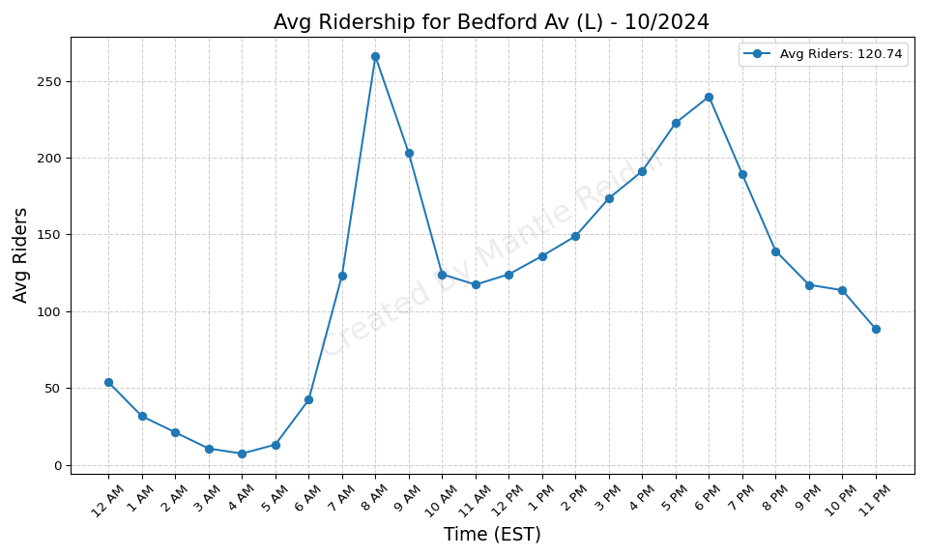
Bedford Av (L) - 10/2024

Slide 11
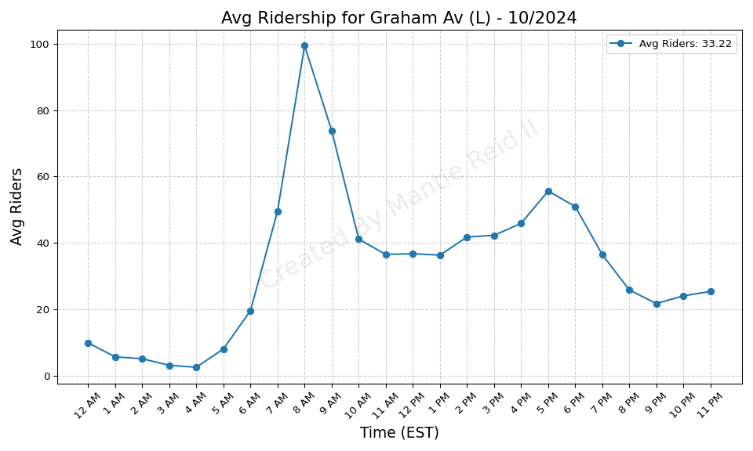
Graham Av (L) - 10/2024

Slide 12
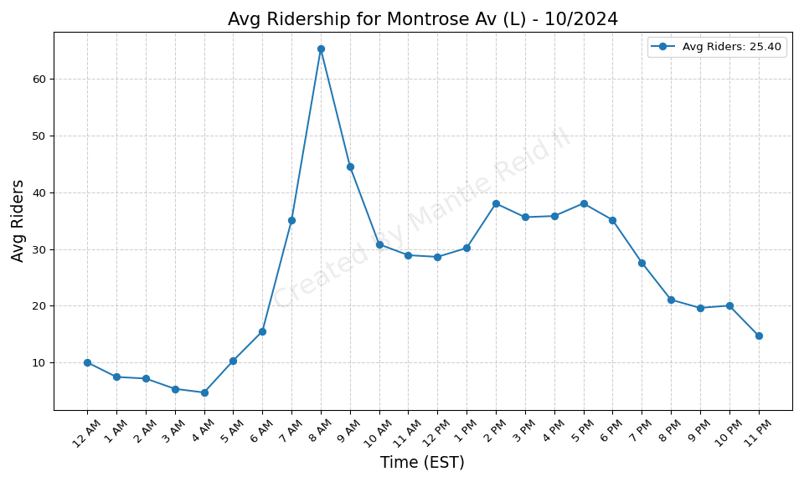
Montrose Av (L) - 10/2024

Slide 13
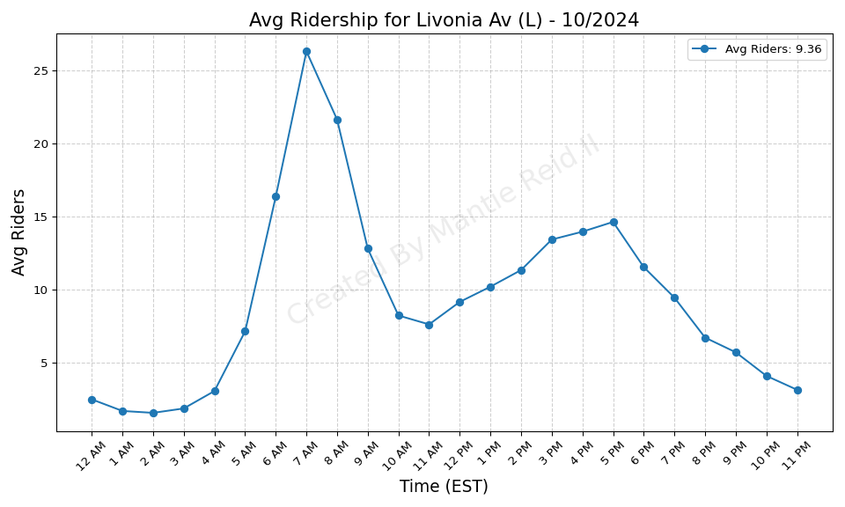
Livonia Av (L) - 10/2024

Slide 14
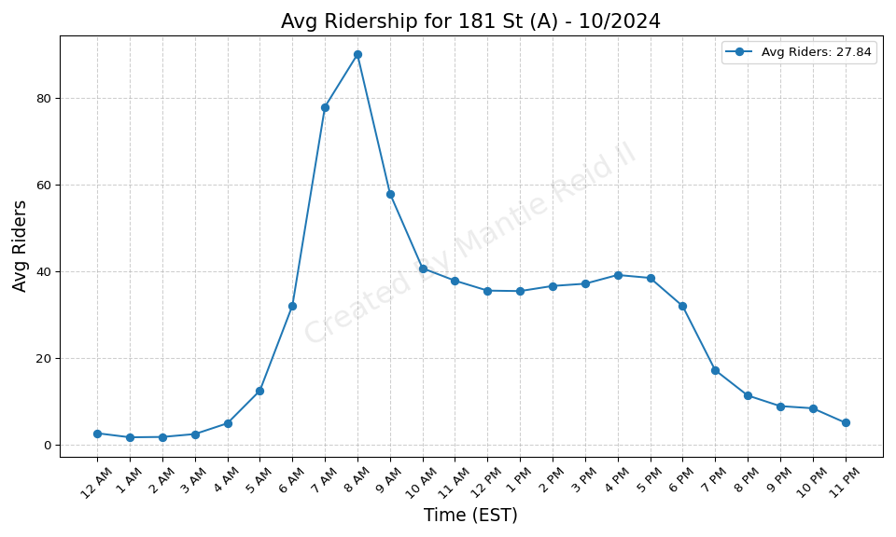
181 St (A) - 10/2024

Slide 15
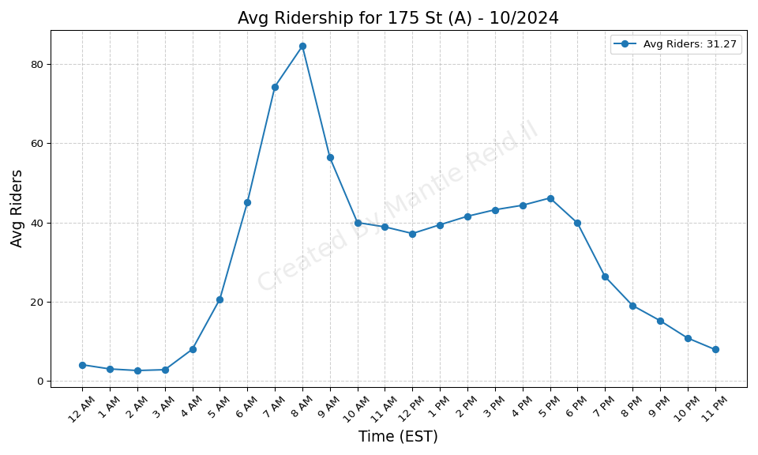
175 St (A) - 10/2024

Slide 16
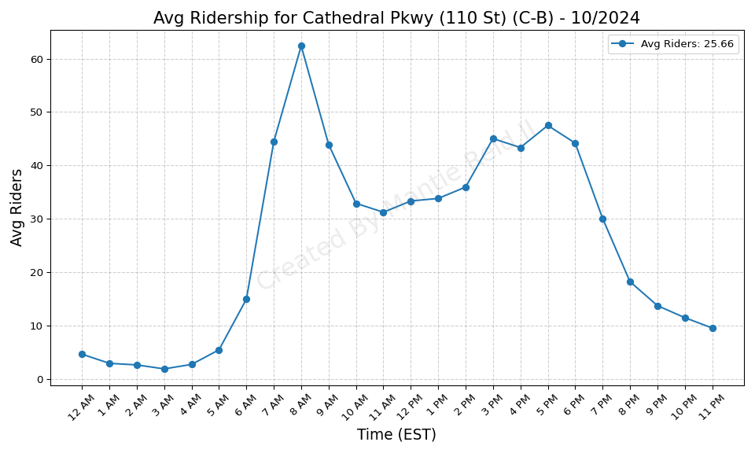
Cathedral Pkwy (110 St) (C-B) - 10/2024

Slide 17
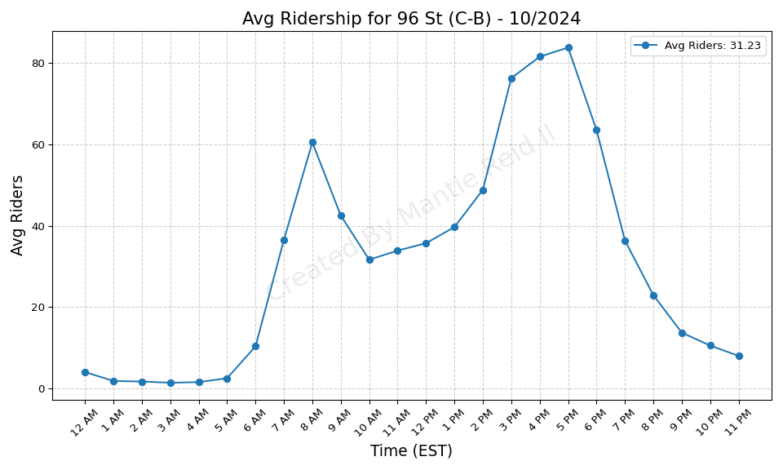
96 St (C-B) - 10/2024

Slide 18
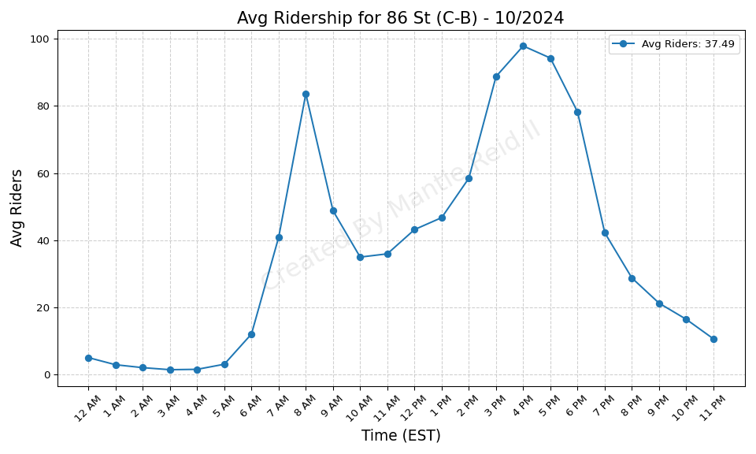
86 St (C-B) - 10/2024

Slide 19
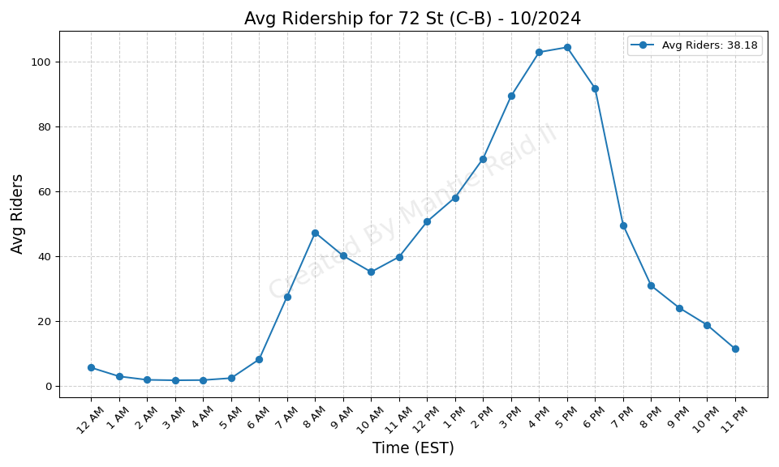
72 St (C-B) - 10/2024

Slide 20
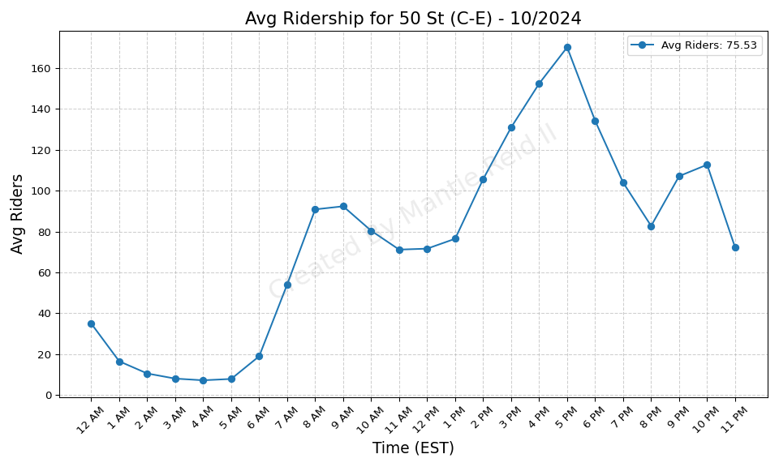
50 St (C-E) - 10/2024

Slide 21
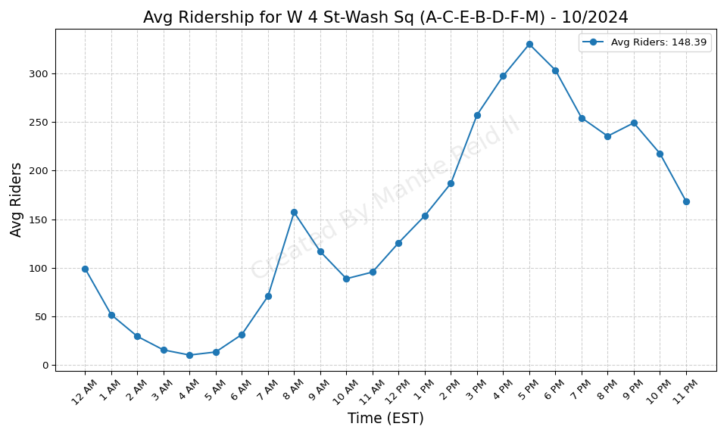
W 4 St-Wash Sq (A-C-E-B-D-F-M) - 10/2024

Slide 22
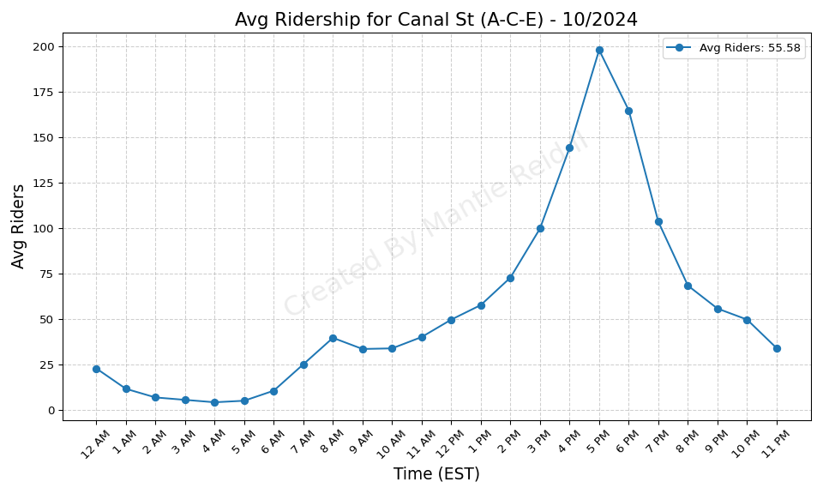
Canal St (A-C-E) - 10/2024

Slide 23
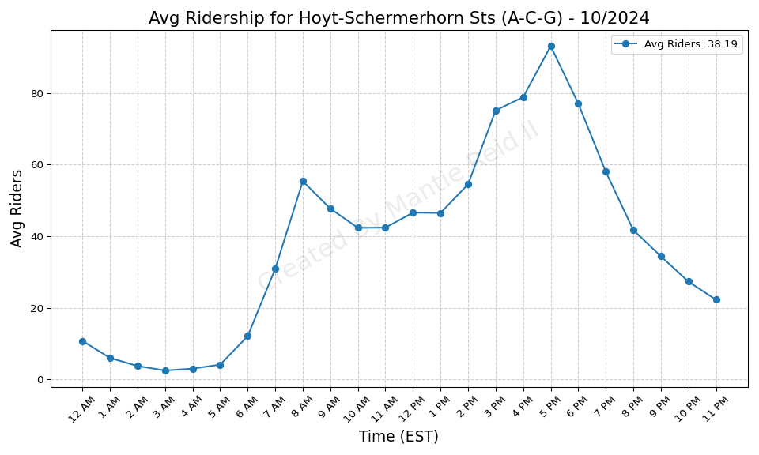
Hoyt-Schermerhorn Sts (A-C-G) - 10/2024

Slide 24
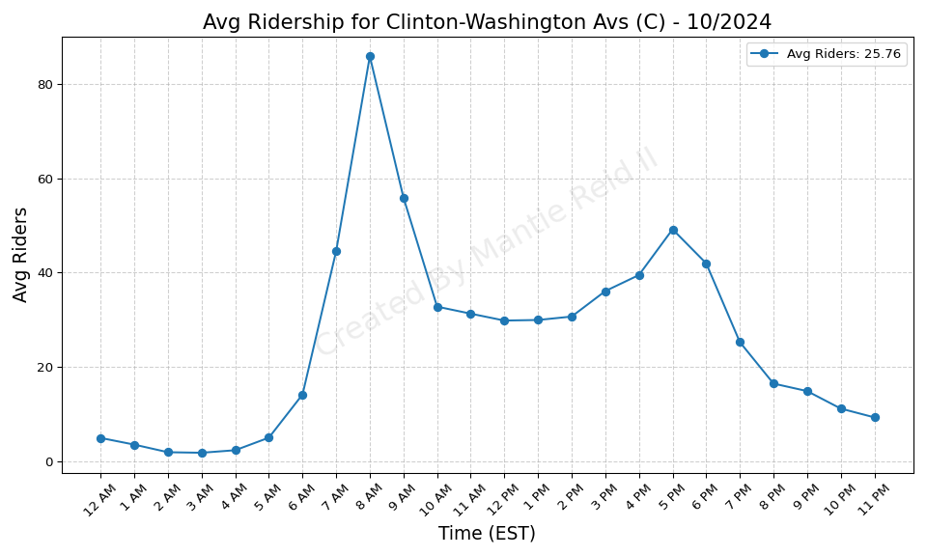
Clinton-Washington Avs (C) - 10/2024

Slide 25
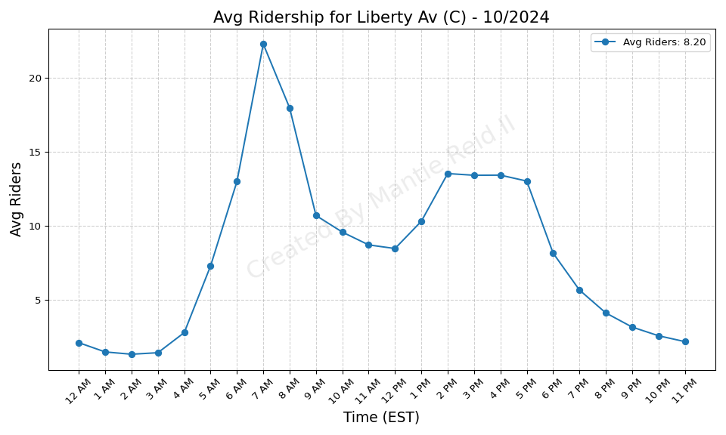
Liberty Av (C) - 10/2024

Slide 26

Shepherd Av (C) - 10/2024

Slide 27
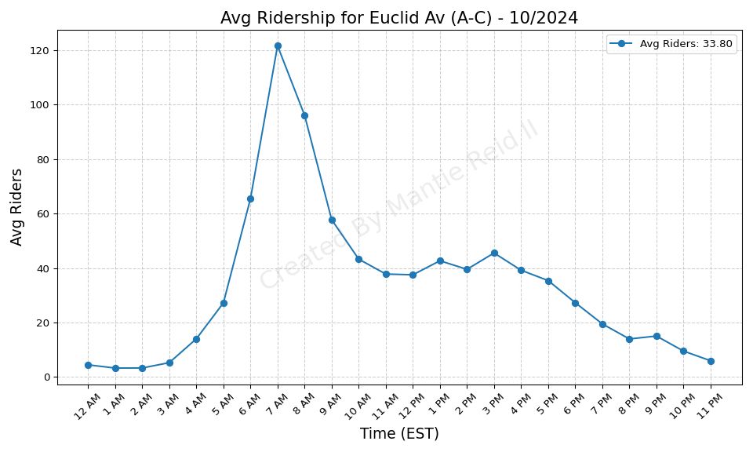
Euclid Av (A-C) - 10/2024

Slide 28

88 St (A) - 10/2024

Slide 29
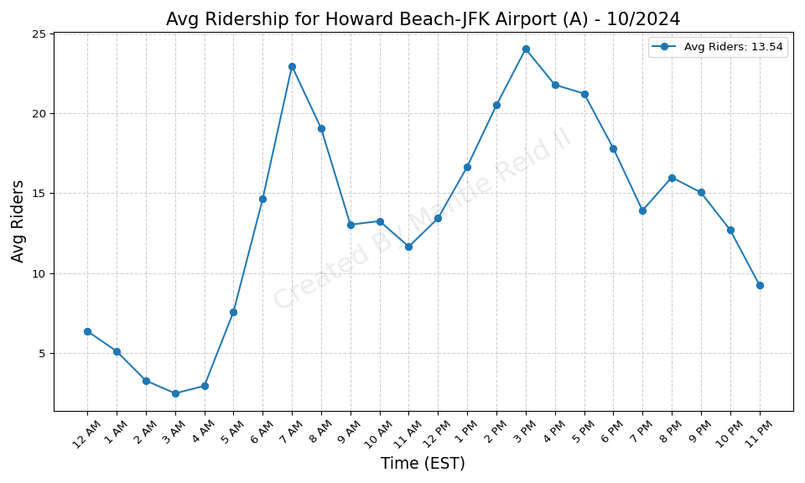
Howard Beach-JFK Airport (A) - 10/2024

Slide 30
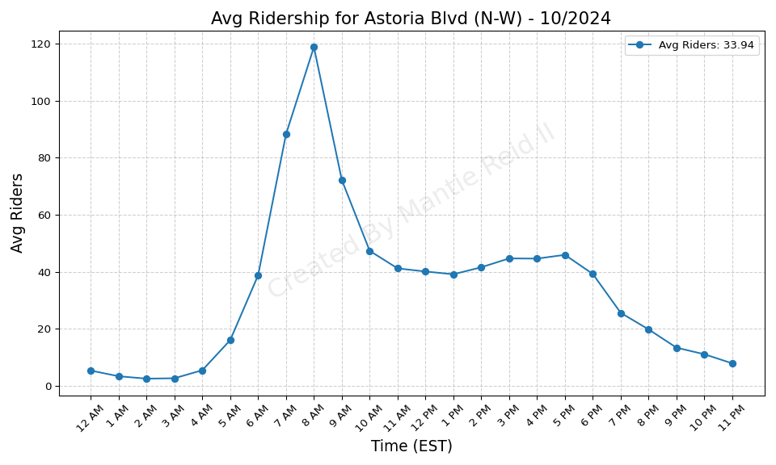
Astoria Blvd (N-W) - 10/2024

Slide 31
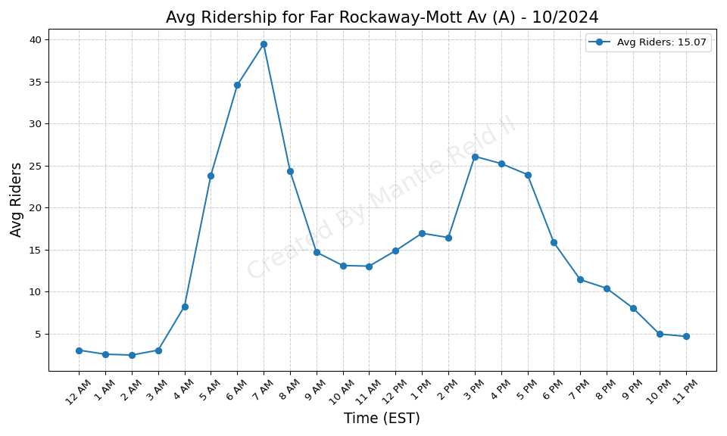
Far Rockaway-Mott Av (A) - 10/2024

Slide 32
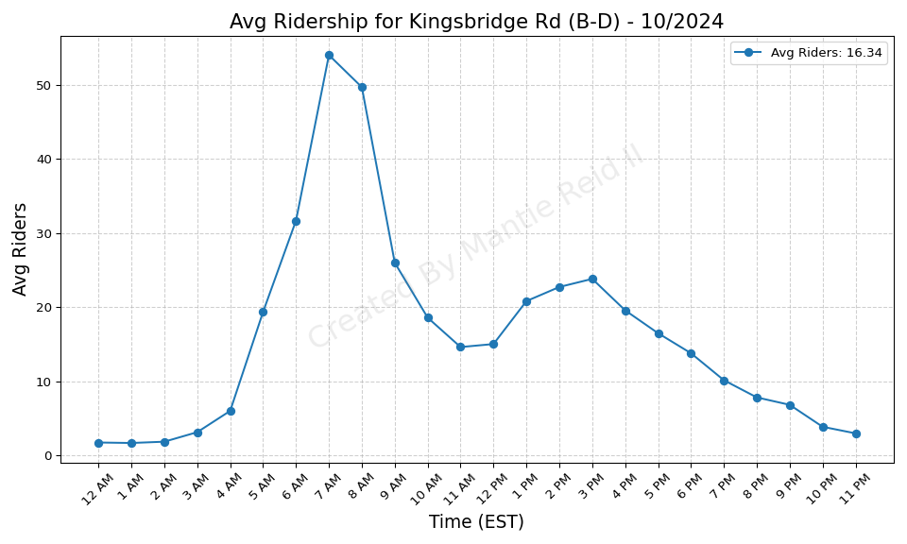
Kingsbridge Rd (B-D) - 10/2024

Slide 33
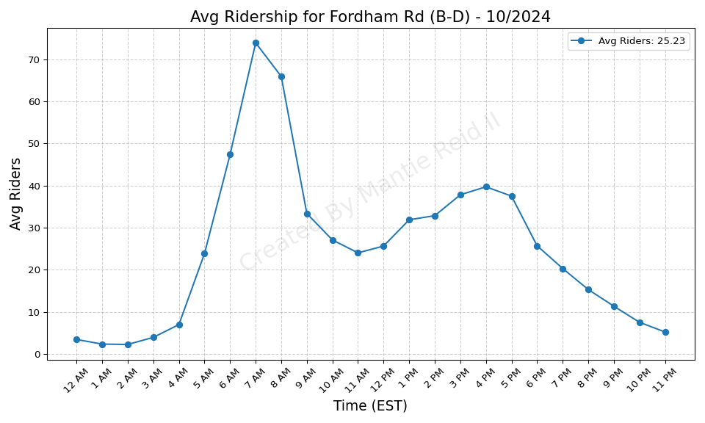
Fordham Rd (B-D) - 10/2024

Slide 34

Tremont Av (B-D) - 10/2024

Slide 35
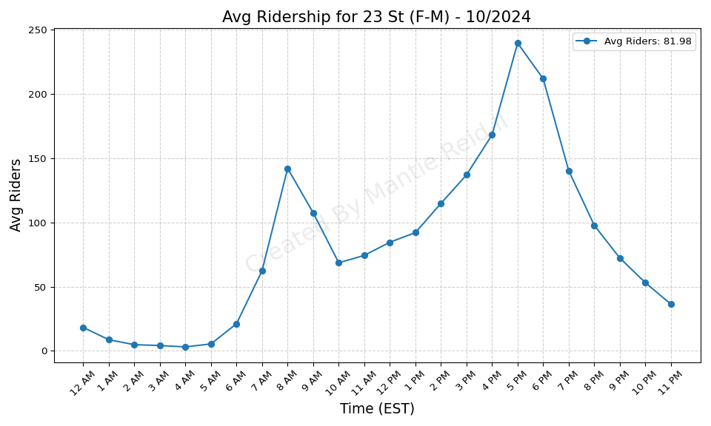
23 St (F-M) - 10/2024

Slide 36
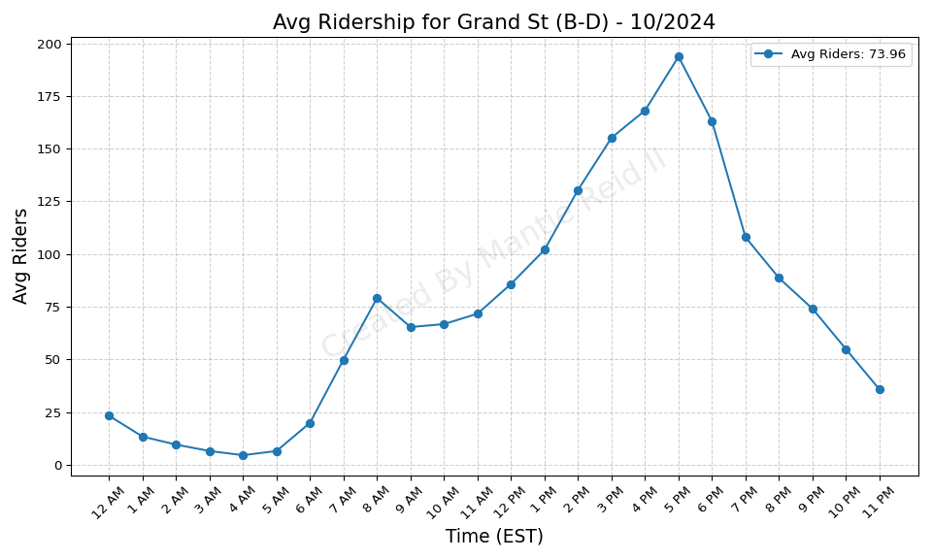
Grand St (B-D) - 10/2024

Slide 37
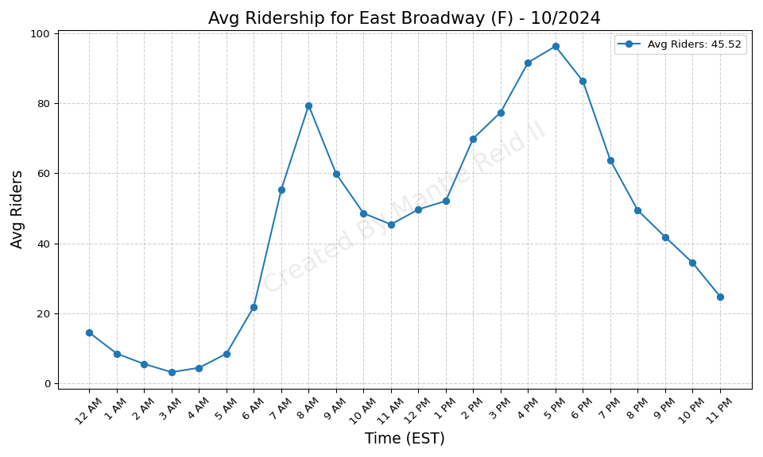
East Broadway (F) - 10/2024

Slide 38
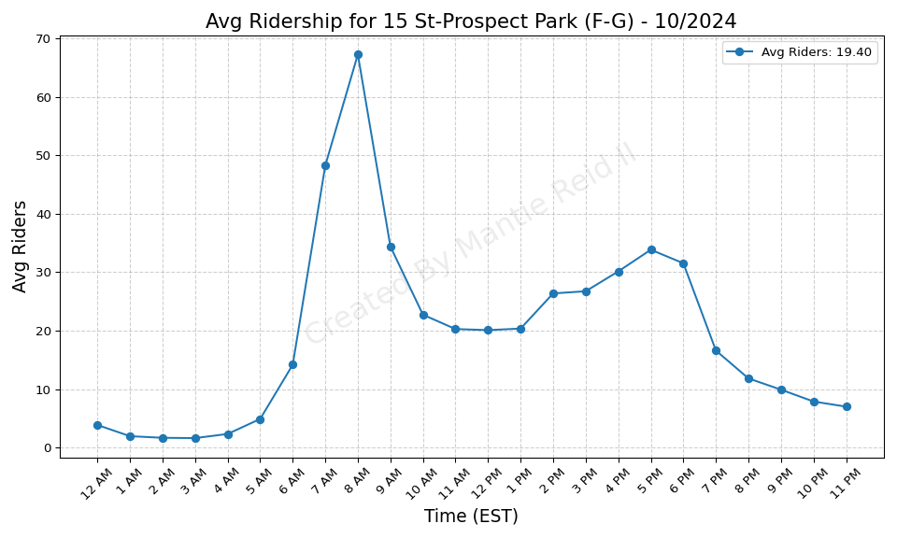
15 St-Prospect Park (F-G) - 10/2024

Slide 39
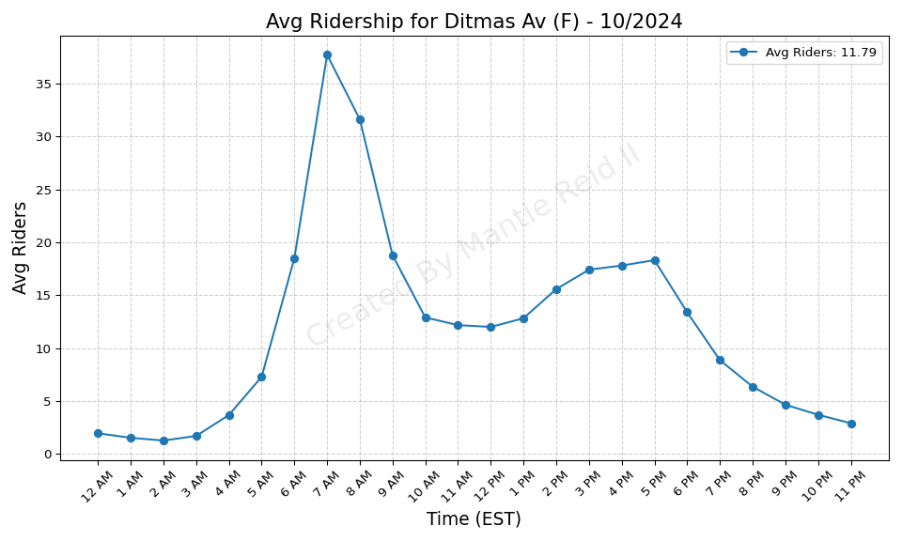
Ditmas Av (F) - 10/2024

Slide 40
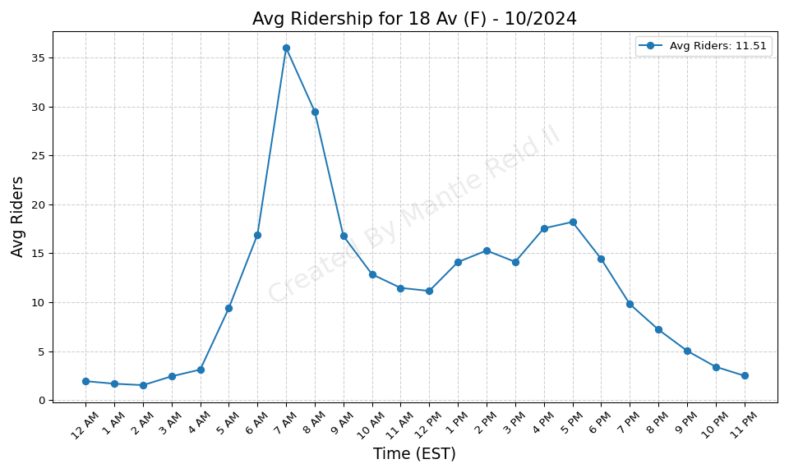
18 Av (F) - 10/2024

Slide 41
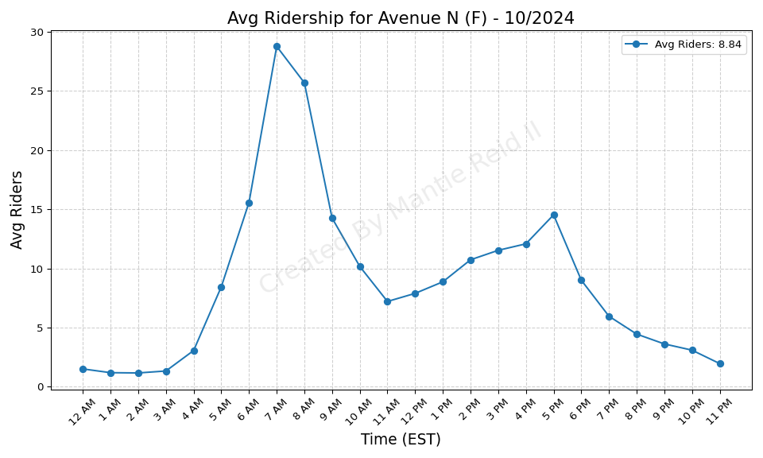
Avenue N (F) - 10/2024

Slide 42
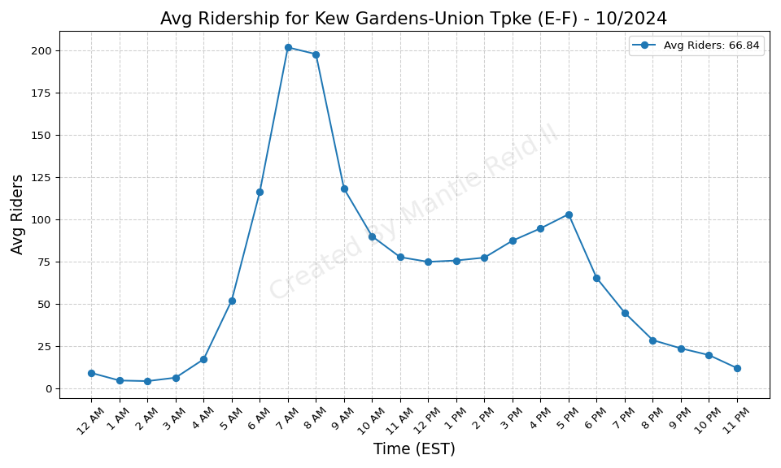
Kew Gardens-Union Tpke (E-F) - 10/2024

Slide 43
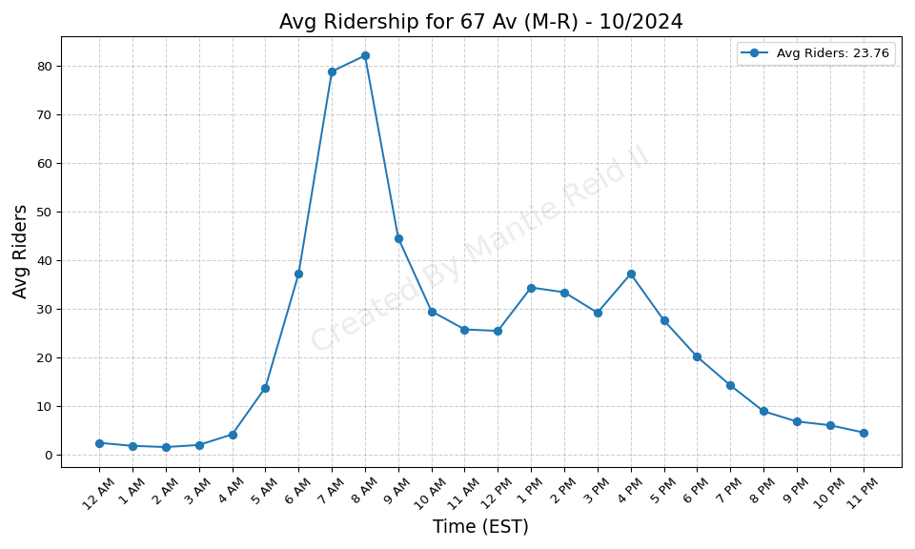
67 Av (M-R) - 10/2024

Slide 44
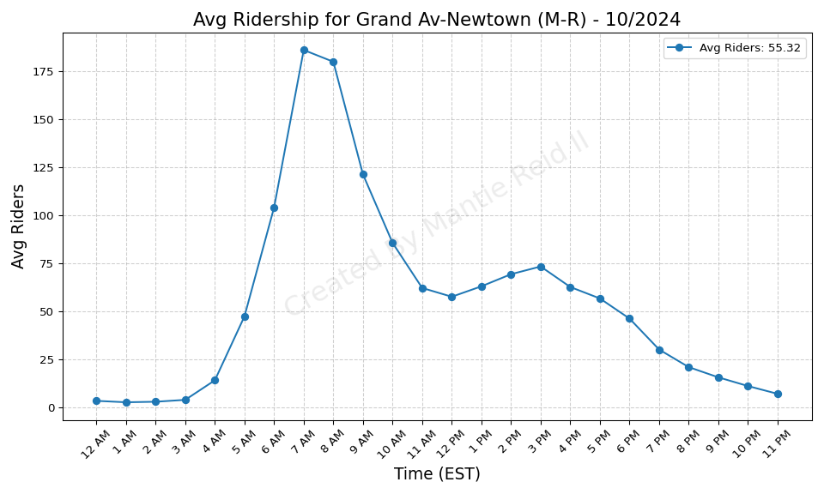
Grand Av-Newtown (M-R) - 10/2024

Slide 45
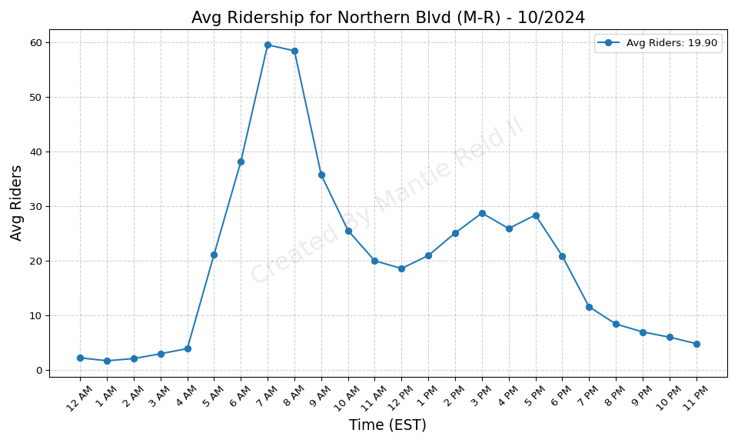
Northern Blvd (M-R) - 10/2024

Slide 46
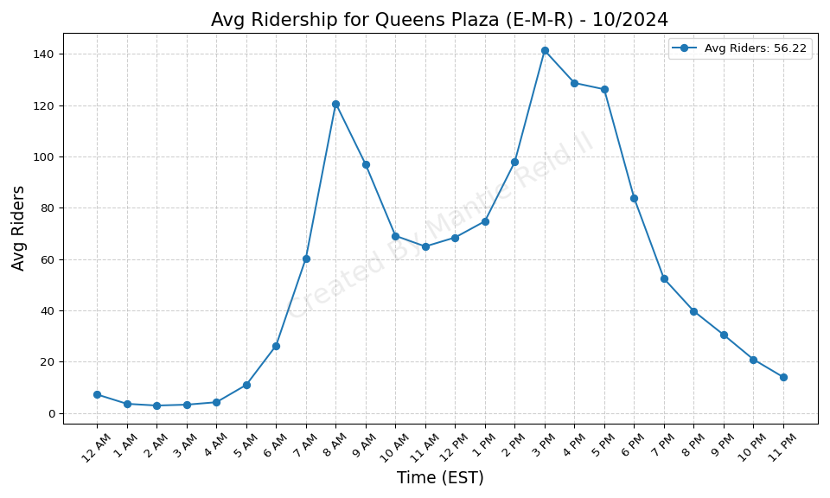
Queens Plaza (E-M-R) - 10/2024

Slide 47
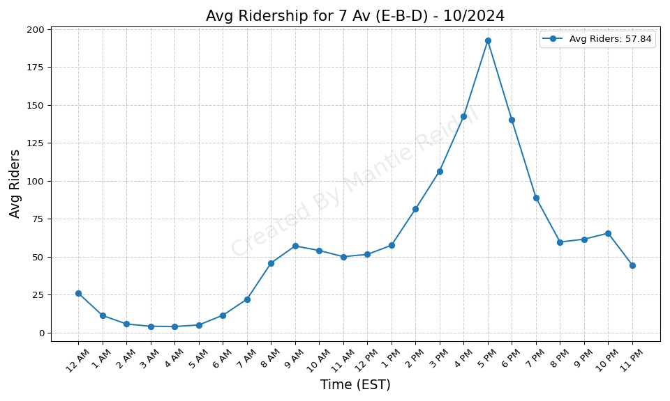
7 Av (E-B-D) - 10/2024

Slide 48
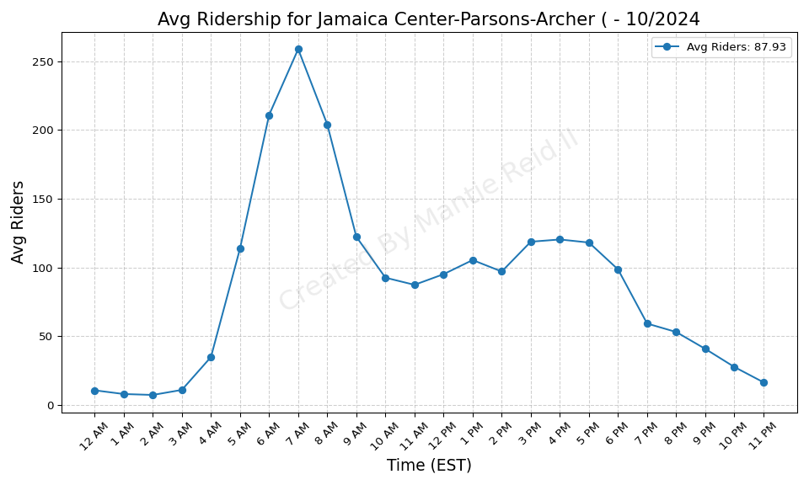
Jamaica Center-Parsons-Archer ( - 10/2024

Slide 49
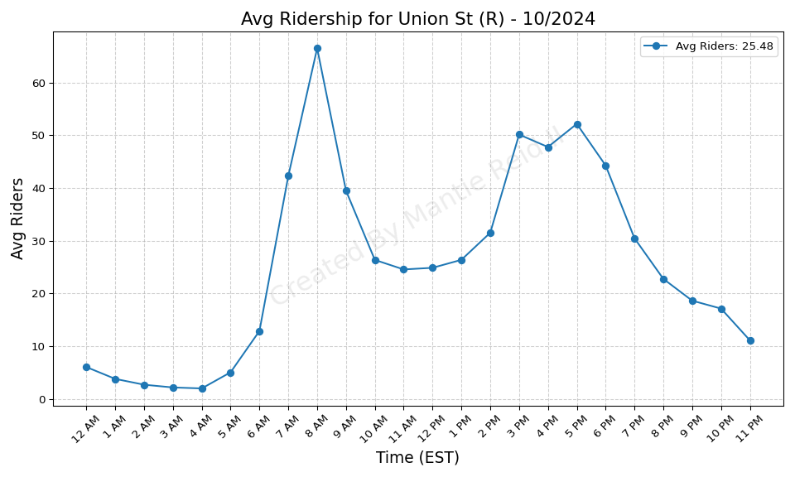
Union St (R) - 10/2024

Slide 50
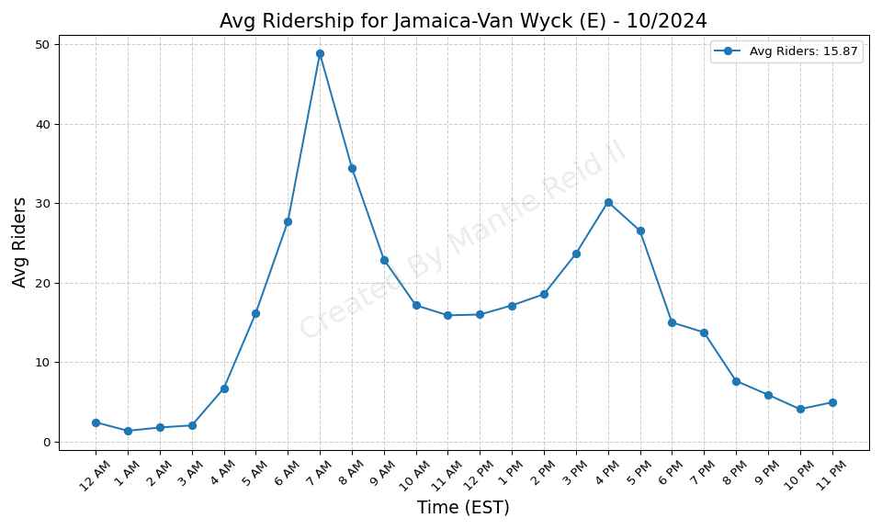
Jamaica-Van Wyck (E) - 10/2024

Slide 51
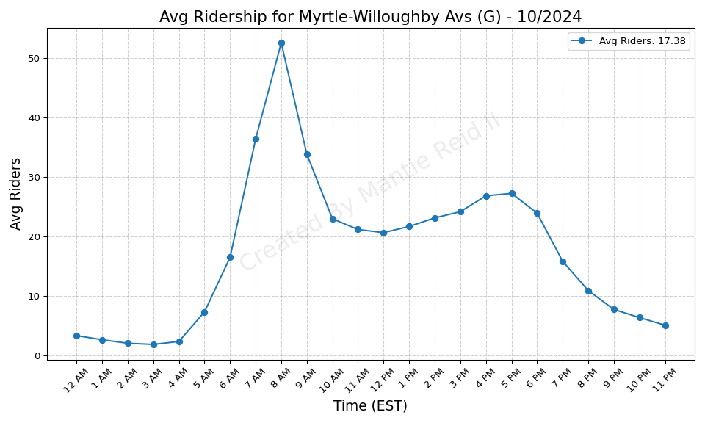
Myrtle-Willoughby Avs (G) - 10/2024

Slide 52
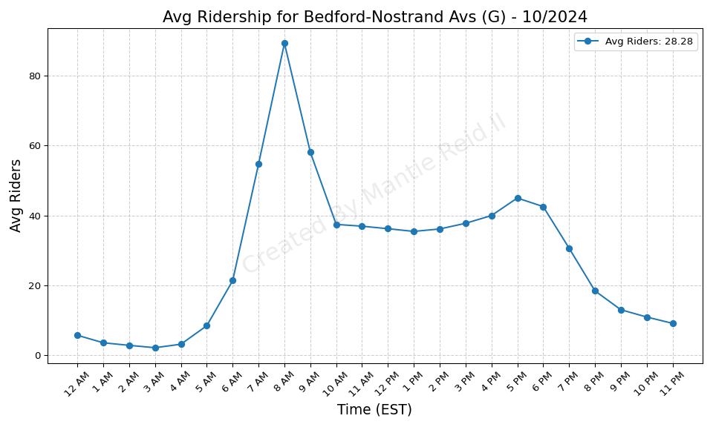
Bedford-Nostrand Avs (G) - 10/2024

Slide 53
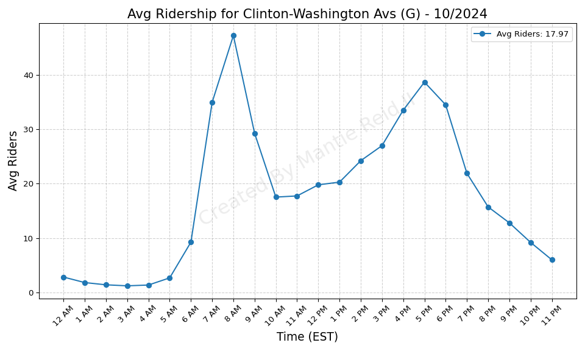
Clinton-Washington Avs (G) - 10/2024

Slide 54

215 St (1) - 10/2024

Slide 55

207 St (1) - 10/2024

Slide 56

137 St-City College (1) - 10/2024

Slide 57

125 St (1) - 10/2024

Slide 58

103 St (1) - 10/2024

Slide 59

25 St (R) - 10/2024

Slide 60

50 St (1) - 10/2024

Slide 61

28 St (1) - 10/2024

Slide 62

18 St (1) - 10/2024

Slide 63

Houston St (1) - 10/2024

Slide 64

Chambers St (1-2-3) - 10/2024

Slide 65

WTC Cortlandt (1) - 10/2024

Slide 66

Wall St (2-3) - 10/2024

Slide 67

Nevins St (2-3-4-5) - 10/2024

Slide 68

Bergen St (2-3) - 10/2024

Slide 69

53 St (R) - 10/2024

Slide 70

Grand Army Plaza (2-3) - 10/2024

Slide 71

Kingston Av (3) - 10/2024

Slide 72

Sutter Av-Rutland Rd (3) - 10/2024

Slide 73

Saratoga Av (3) - 10/2024

Slide 74

Pennsylvania Av (3) - 10/2024

Slide 75

New Lots Av (3) - 10/2024

Slide 76

Sterling St (2-5) - 10/2024

Slide 77

Winthrop St (2-5) - 10/2024

Slide 78

Church Av (2-5) - 10/2024

Slide 79

Newkirk Av-Little Haiti (2-5) - 10/2024

Slide 80

Buhre Av (6) - 10/2024

Slide 81

Brook Av (6) - 10/2024

Slide 82

Mosholu Pkwy (4) - 10/2024

Slide 83

86 St (R) - 10/2024

Slide 84

Bedford Park Blvd-Lehman Colleg - 10/2024

Slide 85

Burnside Av (4) - 10/2024

Slide 86

176 St (4) - 10/2024

Slide 87

Bay Ridge-95 St (R) - 10/2024

Slide 88

138 St-Grand Concourse (4-5) - 10/2024

Slide 89

116 St (6) - 10/2024

Slide 90

103 St (6) - 10/2024

Slide 91

68 St-Hunter College (6) - 10/2024

Slide 92

Wall St (4-5) - 10/2024

Slide 93

Bowling Green (4-5) - 10/2024

Slide 94

Wakefield-241 St (2) - 10/2024

Slide 95

Nereid Av (2-5) - 10/2024

Slide 96

219 St (2-5) - 10/2024

Slide 97

Burke Av (2-5) - 10/2024

Slide 98

Allerton Av (2-5) - 10/2024

Slide 99

Pelham Pkwy (2-5) - 10/2024

Slide 100

E 180 St (2-5) - 10/2024

Slide 101

174 St (2-5) - 10/2024

Slide 102

Parkside Av (Q) - 10/2024

Slide 103

Intervale Av (2-5) - 10/2024

Slide 104

125 St (2-3) - 10/2024

Slide 105

116 St (2-3) - 10/2024

Slide 106

Gun Hill Rd (5) - 10/2024

Slide 107

Pelham Pkwy (5) - 10/2024

Slide 108

Flushing-Main St (7) - 10/2024

Slide 109

90 St-Elmhurst Av (7) - 10/2024

Slide 110

33 St-Rawson St (7) - 10/2024

Slide 111

Hunters Point Av (7) - 10/2024

Slide 112

Avenue J (Q) - 10/2024

Slide 113

Neck Rd (Q) - 10/2024

Slide 114

Brighton Beach (B-Q) - 10/2024

Slide 115

Coney Island-Stillwell Av (D-F- - 10/2024

Slide 116

9 Av (D) - 10/2024

Slide 117

39 Av-Dutch Kills (N-W) - 10/2024

Slide 118

34 St-Herald Sq (B-D-F-M-N-Q-R- - 10/2024

Slide 119

4 Av (F-G)-9 St (R) - 10/2024

Slide 120

Bryant Pk (B-D-F-M)-5 Av (7) - 10/2024

Slide 121

59 St-Columbus Circle (A-B-C-D- - 10/2024

Slide 122

New Utrecht Av (N)-62 St (D) - 10/2024

Slide 123

Atlantic Av-Barclays Ctr (B-D-N - 10/2024

Slide 124

Brooklyn Bridge-City Hall (4-5- - 10/2024

Slide 125

Canal St (J-N-Q-R-W-Z-6) - 10/2024

Slide 126

Chambers St (A-C)-WTC (E)-Park - 10/2024

Slide 127

Delancey St (F)-Essex St (J-M-Z - 10/2024

Slide 128

Myrtle-Wyckoff Avs (L-M) - 10/2024

Slide 129

South Ferry (1)-Whitehall St (R - 10/2024

Slide 130

79 St (D) - 10/2024

Slide 131

86 St (N) - 10/2024

Slide 132

104 St (J-Z) - 10/2024

Slide 133

Woodhaven Blvd (J-Z) - 10/2024

Slide 134

Crescent St (J-Z) - 10/2024

Slide 135

Norwood Av (J-Z) - 10/2024

Slide 136

Cleveland St (J) - 10/2024

Slide 137

Alabama Av (J) - 10/2024

Slide 138

Halsey St (J) - 10/2024

Slide 139

Kosciuszko St (J) - 10/2024

Slide 140

Myrtle Av (M-J-Z) - 10/2024

Slide 141

Lorimer St (M-J) - 10/2024

Slide 142

Hewes St (M-J) - 10/2024

Slide 143

Knickerbocker Av (M) - 10/2024

Slide 144

3 Av (L) - 10/2024

Slide 145

DeKalb Av (L) - 10/2024

Slide 146

Dyckman St (A) - 10/2024

Slide 147

155 St (C) - 10/2024

Slide 148

81 St-Museum of Natural History - 10/2024

Slide 149

Spring St (C-E) - 10/2024

Slide 150

Nostrand Av (A-C) - 10/2024

Slide 151

80 St (A) - 10/2024

Slide 152

Aqueduct Racetrack (A) - 10/2024

Slide 153

182-183 Sts (B-D) - 10/2024

Slide 154

167 St (B-D) - 10/2024

Slide 155

21 St-Queensbridge (F) - 10/2024

Slide 156

57 St (F) - 10/2024

Slide 157

47-50 Sts-Rockefeller Ctr (B-D- - 10/2024

Slide 158

2 Av (F) - 10/2024

Slide 159

Bergen St (F-G) - 10/2024

Slide 160

Smith-9 Sts (F-G) - 10/2024

Slide 161

Church Av (F-G) - 10/2024

Slide 162

Avenue P (F) - 10/2024

Slide 163

Kings Hwy (F) - 10/2024

Slide 164

DeKalb Av (B-Q-R) - 10/2024

Slide 165

63 Dr-Rego Park (M-R) - 10/2024

Slide 166

65 St (M-R) - 10/2024

Slide 167

Steinway St (M-R) - 10/2024

Slide 168

Greenpoint Av (G) - 10/2024

Slide 169

Nassau Av (G) - 10/2024

Slide 170

238 St (1) - 10/2024

Slide 171

231 St (1) - 10/2024

Slide 172

30 Av (N-W) - 10/2024

Slide 173

116 St-Columbia University (1) - 10/2024

Slide 174

72 St (1-2-3) - 10/2024

Slide 175

34 St-Penn Station (1-2-3) - 10/2024

Slide 176

23 St (1) - 10/2024

Slide 177

Christopher St-Sheridan Sq (1) - 10/2024

Slide 178

Canal St (1) - 10/2024

Slide 179

45 St (R) - 10/2024

Slide 180

Rockaway Av (3) - 10/2024

Slide 181

Junius St (3) - 10/2024

Slide 182

59 St (N-R) - 10/2024

Slide 183

President St-Medgar Evers Colle - 10/2024

Slide 184

Middletown Rd (6) - 10/2024

Slide 185

Castle Hill Av (6) - 10/2024

Slide 186

St Lawrence Av (6) - 10/2024

Slide 187

Morrison Av-Soundview (6) - 10/2024

Slide 188

77 St (R) - 10/2024

Slide 189

Whitlock Av (6) - 10/2024

Slide 190

Hunts Point Av (6) - 10/2024

Slide 191

Cypress Av (6) - 10/2024

Slide 192

3 Av-138 St (6) - 10/2024

Slide 193

Mt Eden Av (4) - 10/2024

Slide 194

167 St (4) - 10/2024

Slide 195

96 St (6) - 10/2024

Slide 196

Broadway (N-W) - 10/2024

Slide 197

33 St (6) - 10/2024

Slide 198

23 St (6) - 10/2024

Slide 199

Spring St (6) - 10/2024

Slide 200

7 Av (B-Q) - 10/2024

Slide 201

Prospect Park (B-Q-S) - 10/2024

Slide 202

Gun Hill Rd (2-5) - 10/2024

Slide 203

Bronx Park East (2-5) - 10/2024

Slide 204

145 St (3) - 10/2024

Slide 205

135 St (2-3) - 10/2024

Slide 206

Junction Blvd (7) - 10/2024

Slide 207

69 St (7) - 10/2024

Slide 208

Queensboro Plaza (7-N-W) - 10/2024

Slide 209

Newkirk Plaza (B-Q) - 10/2024

Slide 210

86 St (Q) - 10/2024

Slide 211

72 St (Q) - 10/2024

Slide 212

Avenue H (Q) - 10/2024

Slide 213

Avenue M (Q) - 10/2024

Slide 214

Kings Hwy (B-Q) - 10/2024

Slide 215

14 St (F-M-1-2-3)-6 Av (L) - 10/2024

Slide 216

14 St-Union Sq (L-N-Q-R-W-4-5-6 - 10/2024

Slide 217

168 St (A-C-1) - 10/2024

Slide 218

Grand Central-42 St (S-4-5-6-7) - 10/2024

Slide 219

Times Sq-42 St (N-Q-R-W-S-1-2-3 - 10/2024

Slide 220

Lexington Av-53 St (E-M)-51 St - 10/2024

Slide 221

Lexington Av (N-R-W)-59 St (4-5 - 10/2024

Slide 222

74-Broadway (7)-Jackson Hts-Roo - 10/2024

Slide 223

14 St (A-C-E)-8 Av (L) - 10/2024

Slide 224

Court St (R)-Borough Hall (2-3- - 10/2024

Slide 225

Broadway Junction (A-C-J-L-Z) - 10/2024

Slide 226

Fulton St (A-C-J-Z-2-3-4-5) - 10/2024

Slide 227

Lorimer St (L)-Metropolitan Av - 10/2024

Slide 228

Jay St-MetroTech (A-C-F-R) - 10/2024

Slide 229

20 Av (D) - 10/2024

Slide 230

Bay 50 St (D) - 10/2024

Slide 231

Fort Hamilton Pkwy (N) - 10/2024

Slide 232

20 Av (N) - 10/2024

Slide 233

Bay Pkwy (N) - 10/2024

Slide 234

Kings Hwy (N) - 10/2024

Slide 235

Flushing Av (M-J) - 10/2024

Slide 236

Halsey St (L) - 10/2024

Slide 237

Sutter Av (L) - 10/2024

Slide 238

East 105 St (L) - 10/2024

Slide 239

Inwood-207 St (A) - 10/2024

Slide 240

145 St (A-C-B-D) - 10/2024

Slide 241

116 St (C-B) - 10/2024

Slide 242

34 St-Penn Station (A-C-E) - 10/2024

Slide 243

Lafayette Av (C) - 10/2024

Slide 244

Utica Av (A-C) - 10/2024

Slide 245

Grant Av (A) - 10/2024

Slide 246

Beach 67 St (A) - 10/2024

Slide 247

Norwood-205 St (D) - 10/2024

Slide 248

170 St (B-D) - 10/2024

Slide 249

Lexington Av-63 St (F-Q) - 10/2024

Slide 250

Carroll St (F-G) - 10/2024

Slide 251

169 St (F) - 10/2024

Slide 252

Sutphin Blvd (F) - 10/2024

Slide 253

Forest Hills-71 Av (E-F-M-R) - 10/2024

Slide 254

Woodhaven Blvd (M-R) - 10/2024

Slide 255

Elmhurst Av (M-R) - 10/2024

Slide 256

36 St (M-R) - 10/2024

Slide 257

Van Cortlandt Park-242 St (1) - 10/2024

Slide 258

Prospect Av (R) - 10/2024

Slide 259

Cathedral Pkwy (110 St) (1) - 10/2024

Slide 260

96 St (1-2-3) - 10/2024

Slide 261

86 St (1) - 10/2024

Slide 262

66 St-Lincoln Center (1) - 10/2024

Slide 263

Hoyt St (2-3) - 10/2024

Slide 264

Westchester Sq-E Tremont Av (6) - 10/2024

Slide 265

Longwood Av (6) - 10/2024

Slide 266

Woodlawn (4) - 10/2024

Slide 267

Kingsbridge Rd (4) - 10/2024

Slide 268

125 St (4-5-6) - 10/2024

Slide 269

West Farms Sq-E Tremont Av (2-5 - 10/2024

Slide 270

Simpson St (2-5) - 10/2024

Slide 271

3 Av-149 St (2-5) - 10/2024

Slide 272

Central Park North (110 St) (2- - 10/2024

Slide 273

103 St-Corona Plaza (7) - 10/2024

Slide 274

40 St-Lowery St (7) - 10/2024

Slide 275

96 St (Q) - 10/2024

Slide 276

Court Sq (E-G-M-7) - 10/2024

Slide 277

Broadway-Lafayette St (B-D-F-M) - 10/2024

Slide 278

Van Siclen Av (J-Z) - 10/2024

Slide 279

Chauncey St (J-Z) - 10/2024

Slide 280

Seneca Av (M) - 10/2024

Slide 281

Grand St (L) - 10/2024

Slide 282

Atlantic Av (L) - 10/2024

Slide 283

190 St (A) - 10/2024

Slide 284

23 St (C-E) - 10/2024

Slide 285

Kingston-Throop Avs (C) - 10/2024

Slide 286

Rockaway Blvd (A) - 10/2024

Slide 287

Beach 60 St (A) - 10/2024

Slide 288

Bedford Park Blvd (B-D) - 10/2024

Slide 289

Jamaica-179 St (F) - 10/2024

Slide 290

Parsons Blvd (F) - 10/2024

Slide 291

Briarwood (E-F) - 10/2024

Slide 292

75 Av (E-F) - 10/2024

Slide 293

46 St (M-R) - 10/2024

Slide 294

Marble Hill-225 St (1) - 10/2024

Slide 295

79 St (1) - 10/2024

Slide 296

36 St (D-N-R) - 10/2024

Slide 297

Nostrand Av (3) - 10/2024

Slide 298

Crown Hts-Utica Av (3-4) - 10/2024

Slide 299

Bay Ridge Av (R) - 10/2024

Slide 300

Pelham Bay Park (6) - 10/2024

Slide 301

Parkchester (6) - 10/2024

Slide 302

183 St (4) - 10/2024

Slide 303

110 St (6) - 10/2024

Slide 304

77 St (6) - 10/2024

Slide 305

225 St (2-5) - 10/2024

Slide 306

Church Av (B-Q) - 10/2024

Slide 307

Morris Park (5) - 10/2024

Slide 308

Mets-Willets Point (7) - 10/2024

Slide 309

82 St-Jackson Hts (7) - 10/2024

Slide 310

52 St (7) - 10/2024

Slide 311

34 St-Hudson Yards (7) - 10/2024

Slide 312

Ocean Pkwy (Q) - 10/2024

Slide 313

149 St-Grand Concourse (2-4-5) - 10/2024

Slide 314

Franklin Av (2-3-4-5)-Botanic G - 10/2024

Slide 315

71 St (D) - 10/2024

Slide 316

18 Av (D) - 10/2024

Slide 317

25 Av (D) - 10/2024

Slide 318

8 Av (N) - 10/2024

Slide 319

Avenue U (N) - 10/2024

Slide 320

121 St (J-Z) - 10/2024

Slide 321

85 St-Forest Pkwy (J) - 10/2024

Slide 322

75 St-Elderts Ln (J-Z) - 10/2024

Slide 323

49 St (N-R-W) - 10/2024

Slide 324

Middle Village-Metropolitan Av - 10/2024

Slide 325

Bushwick Av-Aberdeen St (L) - 10/2024

Slide 326

163 St-Amsterdam Av (C) - 10/2024

Slide 327

103 St (C-B) - 10/2024

Slide 328

High St (A-C) - 10/2024

Slide 329

Ozone Park-Lefferts Blvd (A) - 10/2024

Slide 330

Beach 105 St (A-S) - 10/2024

Slide 331

Beach 44 St (A) - 10/2024

Slide 332

Beach 25 St (A) - 10/2024

Slide 333

155 St (B-D) - 10/2024

Slide 334

Roosevelt Island (F) - 10/2024

Slide 335

Avenue X (F) - 10/2024

Slide 336

Neptune Av (F) - 10/2024

Slide 337

Sutphin Blvd-Archer Av-JFK Airp - 10/2024

Slide 338

Dyckman St (1) - 10/2024

Slide 339

191 St (1) - 10/2024

Slide 340

181 St (1) - 10/2024

Slide 341

Rector St (1) - 10/2024

Slide 342

Beverly Rd (2-5) - 10/2024

Slide 343

Flatbush Av-Brooklyn College (2 - 10/2024

Slide 344

E 143 St-St Mary-s St (6) - 10/2024

Slide 345

Fordham Rd (4) - 10/2024

Slide 346

170 St (4) - 10/2024

Slide 347

86 St (4-5-6) - 10/2024

Slide 348

Freeman St (2-5) - 10/2024

Slide 349

Harlem-148 St (3) - 10/2024

Slide 350

Eastchester-Dyre Av (5) - 10/2024

Slide 351

111 St (7) - 10/2024

Slide 352

Beverley Rd (Q) - 10/2024

Slide 353

61 St-Woodside (7) - 10/2024

Slide 354

46 St-Bliss St (7) - 10/2024

Slide 355

36 Av (N-W) - 10/2024

Slide 356

Avenue U (Q) - 10/2024

Slide 357

Sheepshead Bay (B-Q) - 10/2024

Slide 358

W 8 St-NY Aquarium (F-Q) - 10/2024

Slide 359

161 St-Yankee Stadium (B-D-4) - 10/2024

Slide 360

Central Av (M) - 10/2024

Slide 361

Morgan Av (L) - 10/2024

Slide 362

New Lots Av (L) - 10/2024

Slide 363

Canarsie-Rockaway Pkwy (L) - 10/2024

Slide 364

23 St (R-W) - 10/2024

Slide 365

Park Pl (S) - 10/2024

Slide 366

8 St-NYU (R-W) - 10/2024

Slide 367

Rockaway Av (C) - 10/2024

Slide 368

111 St (A) - 10/2024

Slide 369

Aqueduct-N Conduit Av (A) - 10/2024

Slide 370

Beach 90 St (A-S) - 10/2024

Slide 371

21 St (G) - 10/2024

Slide 372

Classon Av (G) - 10/2024

Slide 373

157 St (1) - 10/2024

Slide 374

145 St (1) - 10/2024

Slide 375

Franklin St (1) - 10/2024

Slide 376

E 149 St (6) - 10/2024

Slide 377

28 St (6) - 10/2024

Slide 378

Prospect Av (2-5) - 10/2024

Slide 379

Jackson Av (2-5) - 10/2024

Slide 380

Vernon Blvd-Jackson Av (7) - 10/2024

Slide 381

Franklin Av (C-S) - 10/2024

Slide 382

Bay Pkwy (D) - 10/2024

Slide 383

18 Av (N) - 10/2024

Slide 384

57 St-7 Av (N-Q-R-W) - 10/2024

Slide 385

Forest Av (M) - 10/2024

Slide 386

Prince St (R-W) - 10/2024

Slide 387

Ralph Av (C) - 10/2024

Slide 388

Van Siclen Av (C) - 10/2024

Slide 389

104 St (A) - 10/2024

Slide 390

Broad Channel (A-S) - 10/2024

Slide 391

Beach 98 St (A-S) - 10/2024

Slide 392

174-175 Sts (B-D) - 10/2024

Slide 393

York St (F) - 10/2024

Slide 394

7 Av (F-G) - 10/2024

Slide 395

Fort Hamilton Pkwy (F-G) - 10/2024

Slide 396

Avenue U (F) - 10/2024

Slide 397

5 Av-53 St (E-M) - 10/2024

Slide 398

Flushing Av (G) - 10/2024

Slide 399

Van Siclen Av (3) - 10/2024

Slide 400

Zerega Av (6) - 10/2024

Slide 401

Elder Av (6) - 10/2024

Slide 402

Astor Pl (6) - 10/2024

Slide 403

233 St (2-5) - 10/2024

Slide 404

Baychester Av (5) - 10/2024

Slide 405

50 St (D) - 10/2024

Slide 406

5 Av-59 St (N-R-W) - 10/2024

Slide 407

Gates Av (J-Z) - 10/2024

Slide 408

Tompkinsville (SIR) - 10/2024

Slide 409

28 St (R-W) - 10/2024

Slide 410

Rockaway Park-Beach 116 St (A-S - 10/2024

Slide 411

Beach 36 St (A) - 10/2024

Slide 412

Avenue I (F) - 10/2024

Slide 413

Bay Pkwy (F) - 10/2024

Slide 414

Fulton St (G) - 10/2024

Slide 415

Cortelyou Rd (Q) - 10/2024

Slide 416

111 St (J) - 10/2024

Slide 417

Jefferson St (L) - 10/2024

Slide 418

City Hall (R-W) - 10/2024

Slide 419

Broadway (G) - 10/2024

Slide 420

Rector St (R-W) - 10/2024

Slide 421

Clark St (2-3) - 10/2024

Slide 422

Eastern Pkwy-Brooklyn Museum (2 - 10/2024

Slide 423

Fort Hamilton Pkwy (D) - 10/2024

Slide 424

55 St (D) - 10/2024

Slide 425

Cypress Hills (J) - 10/2024

Slide 426

Wilson Av (L) - 10/2024

Slide 427

RI Tramway (Roosevelt) - 10/2024

Slide 428

RI Tramway (Manhattan) - 10/2024

